Slide 1
Lecture 14:
Reactions of alkenes:
Rearrangements of carbocations
Hydration

Slide 2
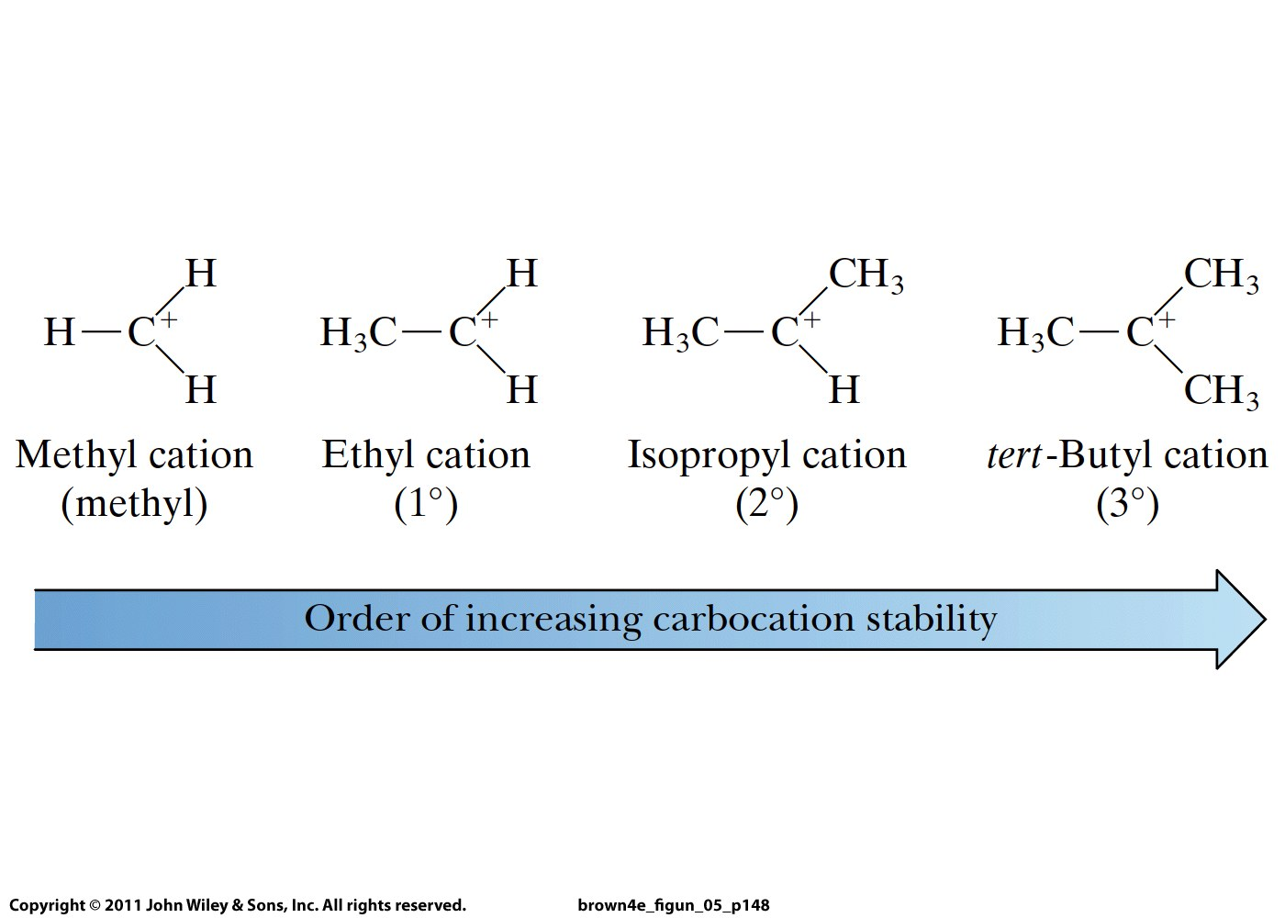

Slide 3
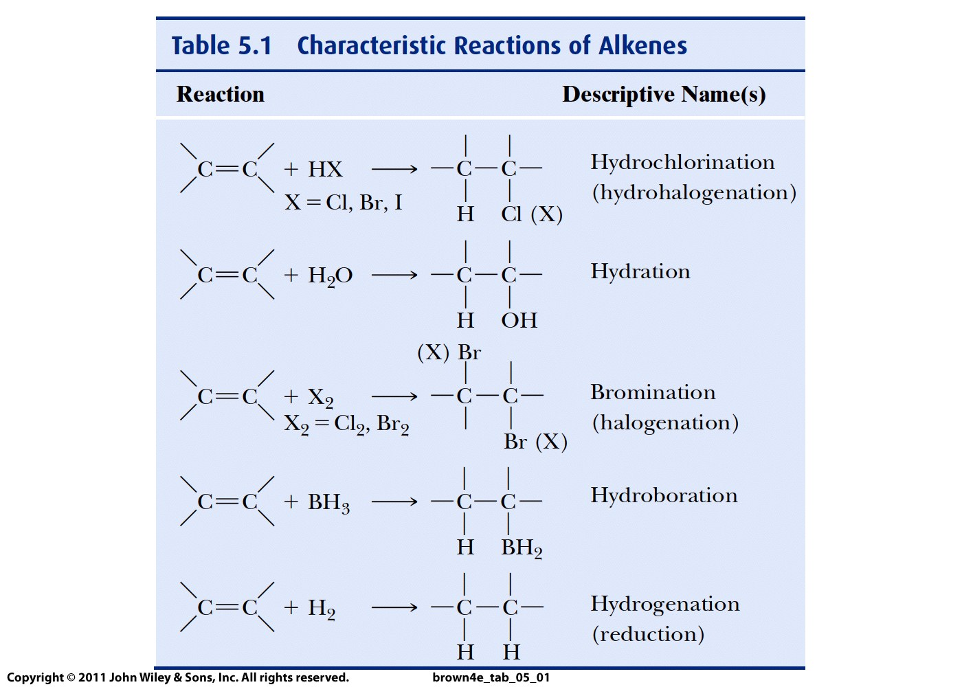

Slide 4
Mechanism

Slide 5
Addition of water to C=C = hydration
Requires acid catalysis to activate water
After that, reaction follows the same mechanism
as hydrohalogenation
Carbocation intermediate or intermediates are formed
They may undergo rearrangement if this leads to a
more stable carbocation
Addition of water generates a second reaction
intermediate, an oxonium ion
The product is an alcohol (or alcohols)
Reaction follows Markovnikov rule

Slide 7
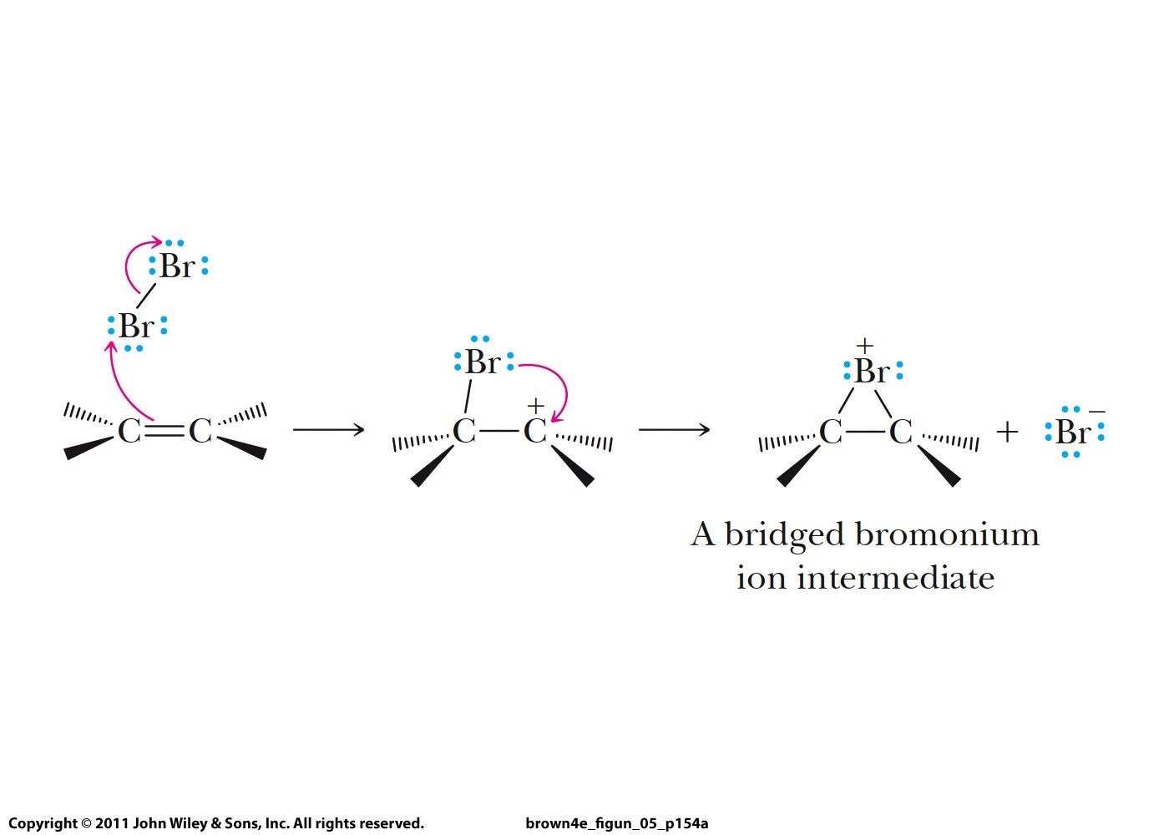

Slide 8
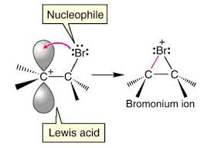

Slide 9
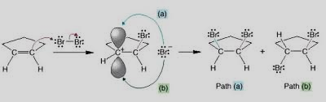

Slide 10
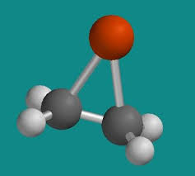

Slide 11
